Slide 1
Recap
Dutch Azure Meetup
Marco Mansi

Slide 4
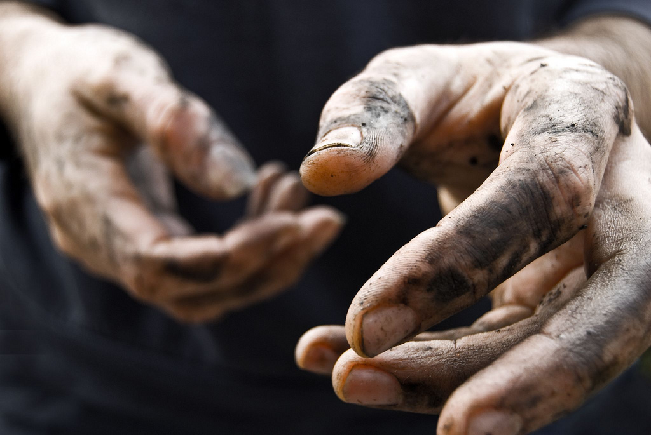
http://xpir.it/dambd

